Slide 1

Visual Merchandising

Slide 2
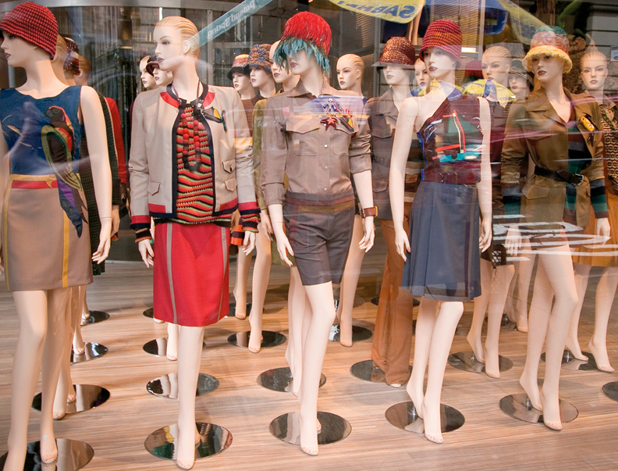
Chapter 18 Visual Merchandising and Display
Section 18.1 Display Features
Section 18.2 Artistic Design

Slide 3


Slide 4

Why is what you see important?
Assignment:
Go to Google Classroom and complete the Web Project

Slide 5
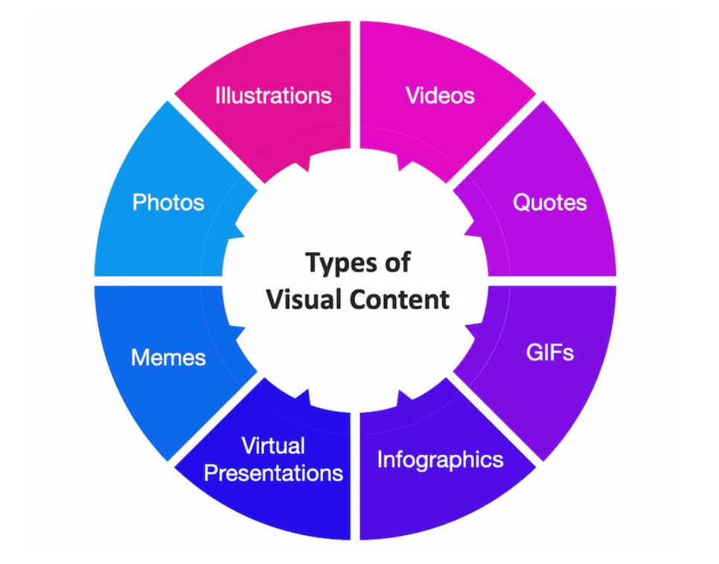
Visuals Used:
What is Visual Marketing:
Visual Marketing is the use of images, videos, graphics, and other visual content to promote a brand, product, or service and engage customers.
Key points:
Focuses on appealing visuals rather than just text
Helps communicate brand identity quickly
Can increase customer attention, retention, and engagement
Used in social media, websites, advertisements, and in-store displays

Slide 6
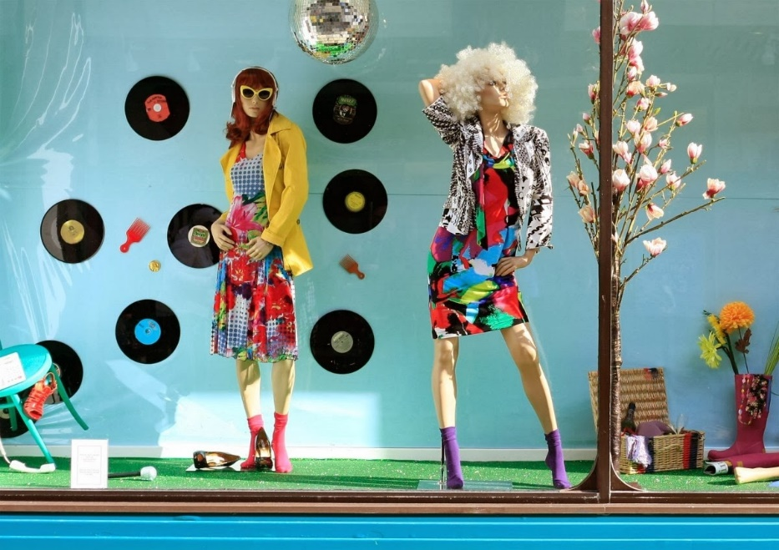
What is Visual Merchandising:
(A piece of Visual Marketing)
Visual Merchandising: using artistic elements when designing store layouts and displays to showcase products in a way that makes them visually appealing or desirable.
Key points:
Uses colors, lighting, signage, props, and product placement strategically
Tells a brand story visually
Can influence customer behavior and increase sales
Examples:
Applies to floor plan layout, window displays, in-store setups, and point-of-purchase areas

Slide 7
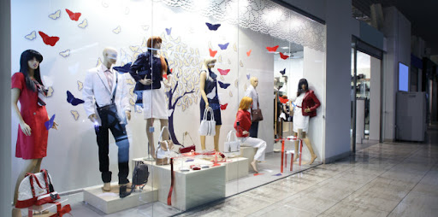
Purpose of Visual Marketing:
The Goal is to:
Attract Shoppers to Increase Sales
Create a brand identity

Slide 8
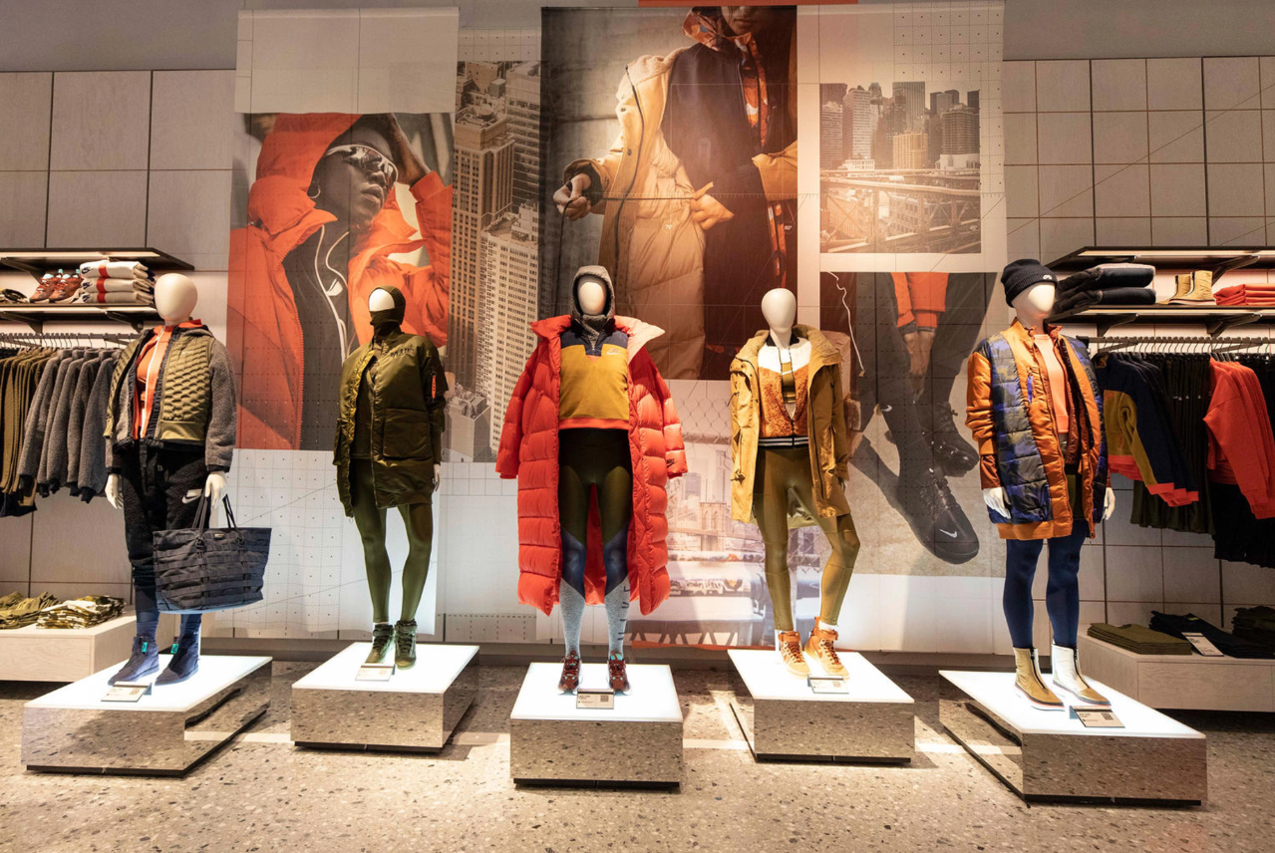
Importance of Visual Merchandising
Why It Matters:
• Increases customer engagement
• Boosts sales and revenue
• Differentiates your brand from competitors
• Enhances store atmosphere
💡 65% of shoppers decide on purchases based on displays!

Slide 9

Assignment: Complete the ED Puzzle in Google Classroom. Fill in your notes for 5 Elements of Visual Merchandising on Page 2
Check to see if Mrs. Vetter Signed your notes before we proceed. No points if not signed for note packet

Slide 11
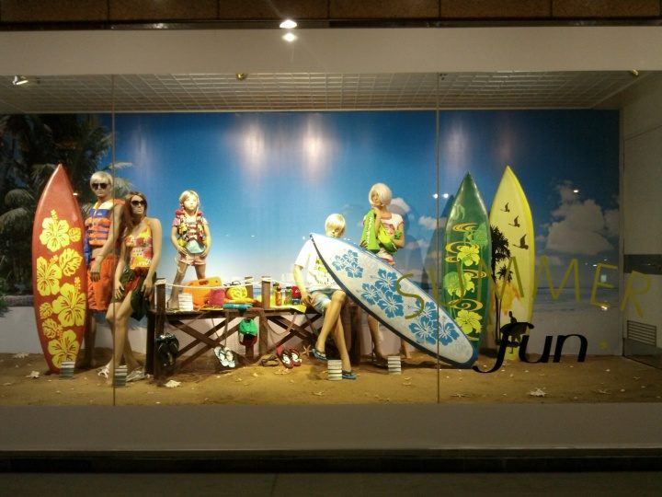
Elements of Visual Merchandising
There are many different types of visual merchandising. Here are some of the most used forms:
Window Displays
Mannequin display
Floor merchandising
Signage
Graphics

Slide 12
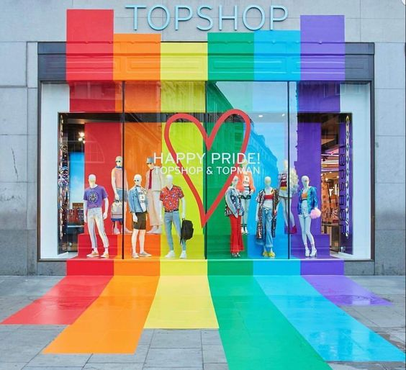
Type of Visual Merchandising
Window display - This is the product display in the storefront
The first thing a passerby sees
Purpose It's meant to communicate the brand's image and grab the attention of shoppers to entice them to enter the store.

Slide 13
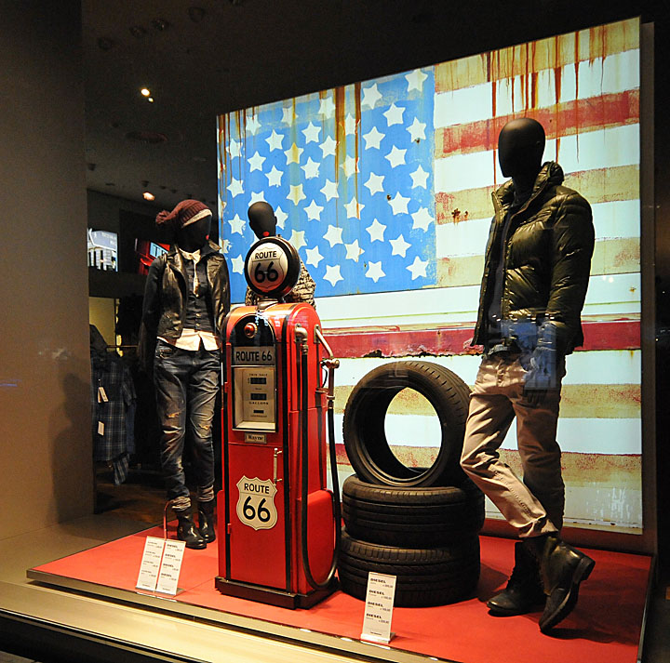
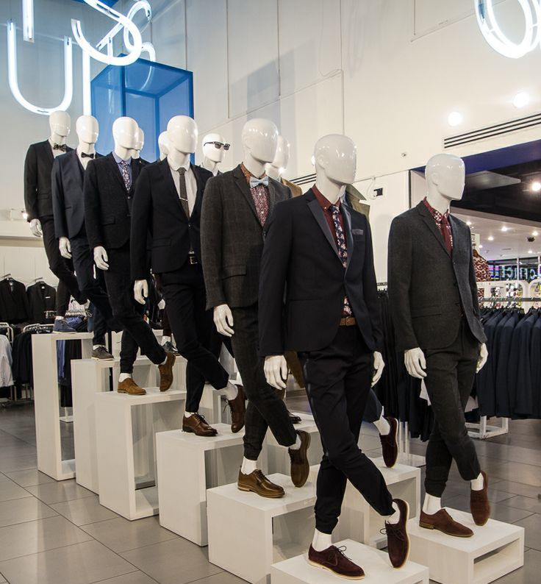
Type of Visual Merchandising
Mannequin display - Shows how product can be used in everyday life.
Most useful tools in visual merchandising
Shows product options
For clothing shows off the fit, style, and colors of the product

Slide 14
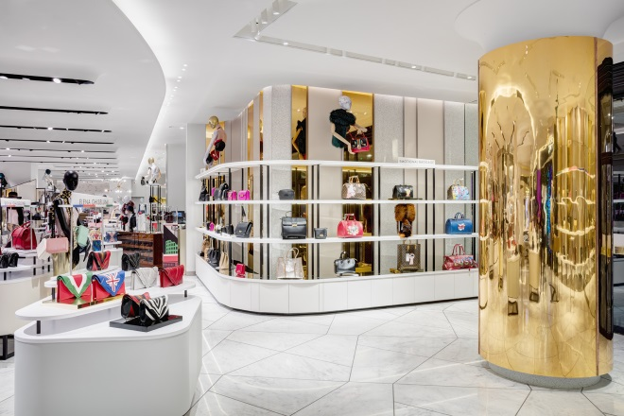
Type of Visual Merchandising
Floor merchandising - This refers to the way products are arranged on the shelves or store fixtures inside the store
Good floor merchandising will optimize the retail space
Products are visible, easily accessible, organized, and pleasing to the eye.
Ex: organized by size, color, shapes, style

Slide 15
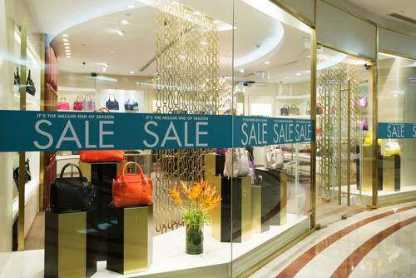
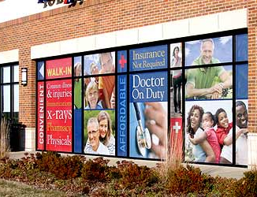
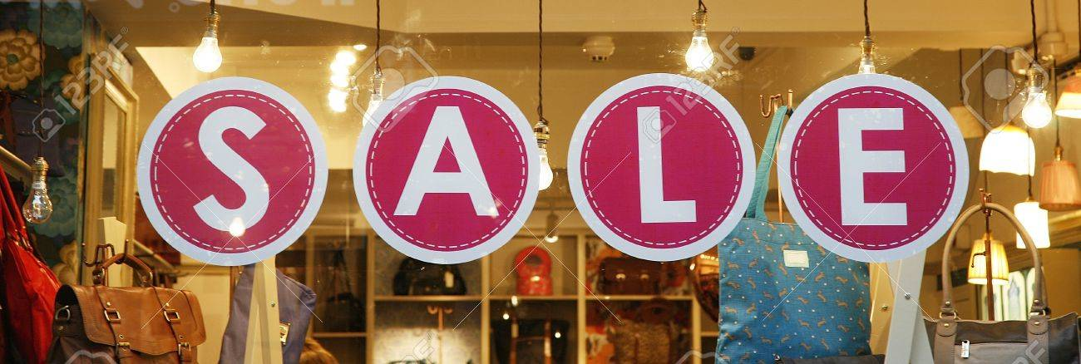
Type of Visual Merchandising
Signage - This is wording used alone or together with a product display to convey a message
Signage may tell shoppers what the product simply is, promotional events, hours, or orient customers around the store.

Slide 16
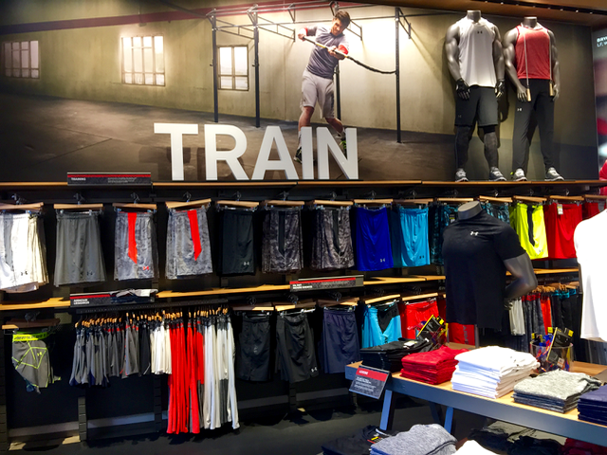
Type of Visual Merchandising
Graphics - include images such as photographs, illusions, or paintings.
Used by retailers to trigger specific emotions and emotional experiences within shoppers.
Graphics are also used to attract attention
Ex: . For example, a photo of a tropical beach might make a shopper feel instantly relaxed

Slide 17
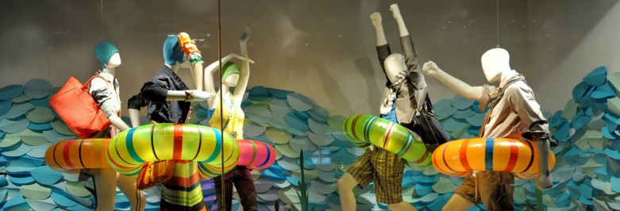
Graphics Continued
Props: an item or group of items you used to tell your product's message. It is usually placed in a window display, floor display or stand alone
List this as part of your definition of Graphics:
What is the message?
Would you know this without the rubber water tubes?

Slide 18
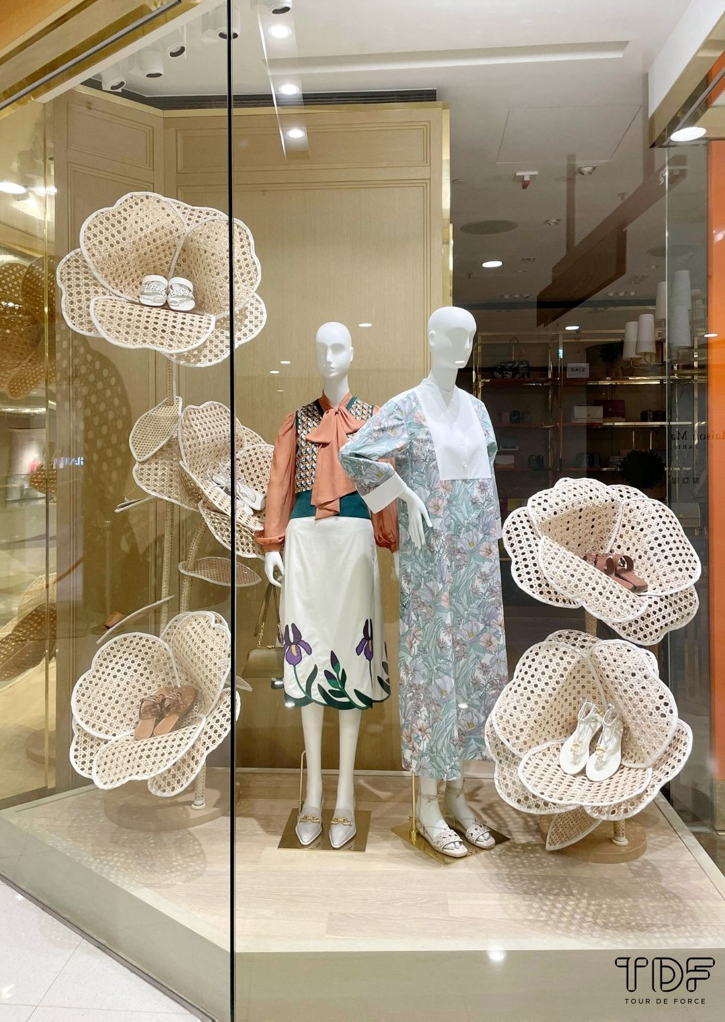
What was visual merchandising techniques are used here?
Window Display
Graphics
Mannequin’s

Slide 19
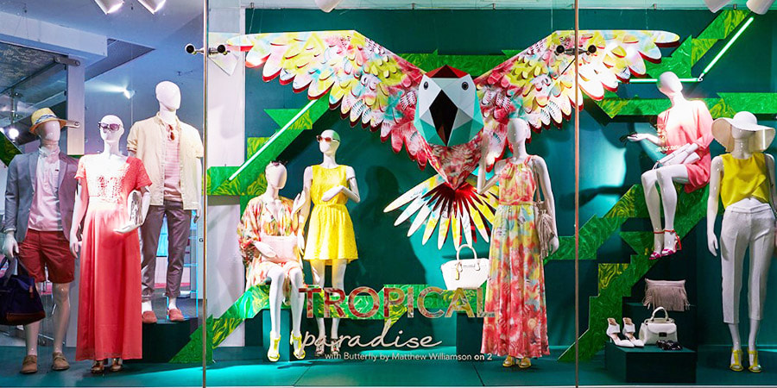
What was visual merchandising techniques are used here?
Window Display
Graphics
Mannequin’s
Signage

Slide 20
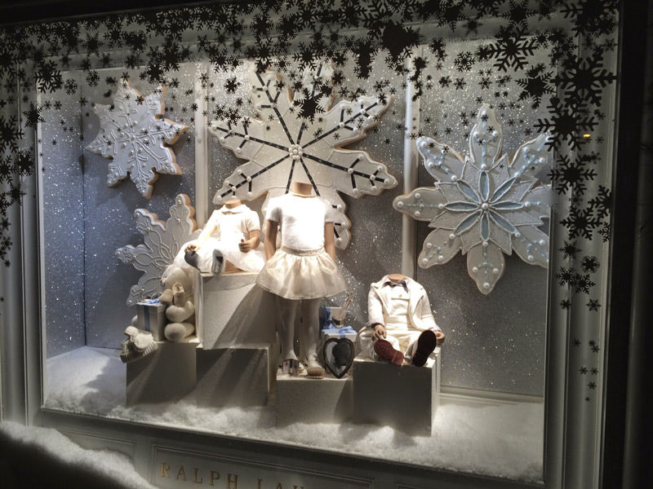
What was visual merchandising techniques are used here?
Window Display
Graphics
Mannequin’s

Slide 21
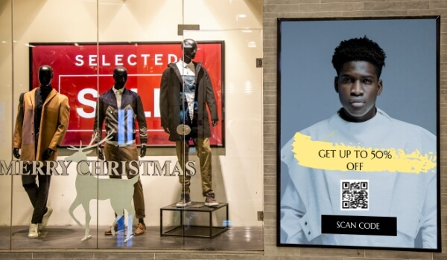
What was visual merchandising techniques are used here?
Window Display
Graphics
Mannequin’s
Signage

Slide 22
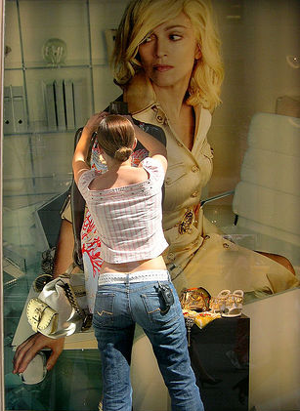
Visual Merchandiser
Visual Merchandiser: individuals hired to use their design skills to help promote the image, products and services of retail businesses and other organizations.
They create eye-catching product displays and store layouts to attract customers that will entice them to buy
Large corporations have teams
Small businesses rely on the skill of their employees

Slide 23
Go to Google Classroom and Complete the Assignment Elements of Visual Merchandising

Slide 24
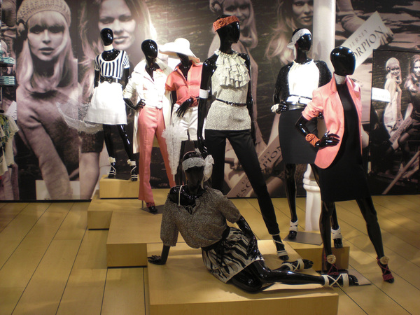
Spaces to Apply Visual Merchandising
Storefront
Store Interior
Store Layout

Slide 25
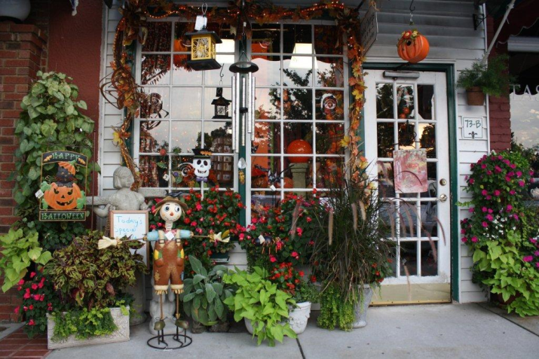
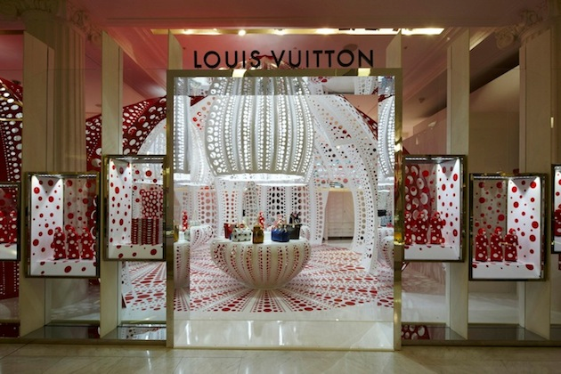
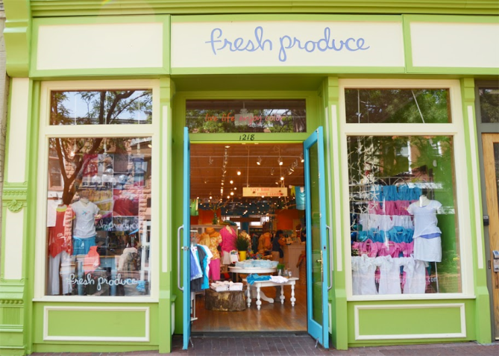
1. storefront X exterior elements of a business used to attract customers and tell who you are and what you sell
Store Front
Store Front Elements:
Sign, logo, or banners
Marquee or awning
Planters and exterior window displays
Exterior design landscaping, and outdoor lighting

Slide 26
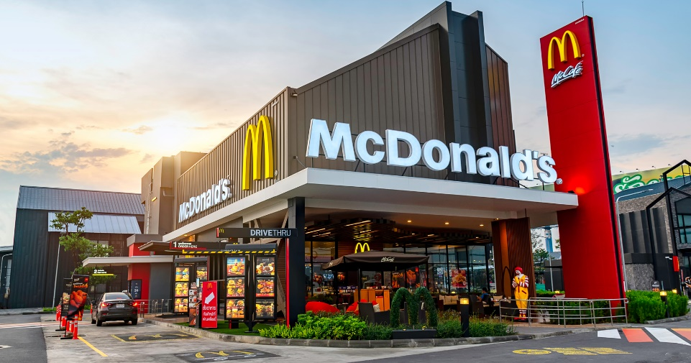
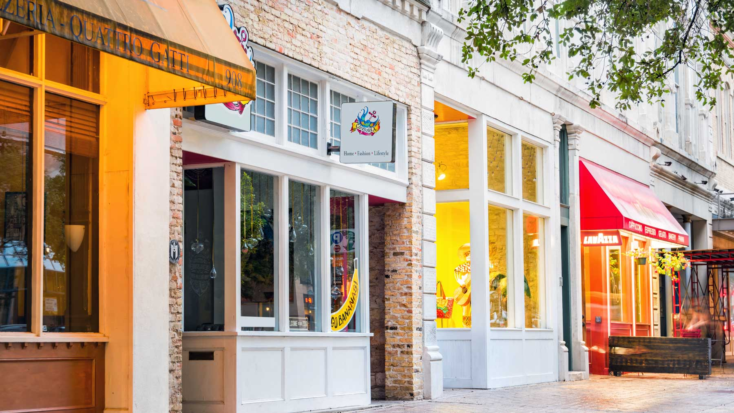
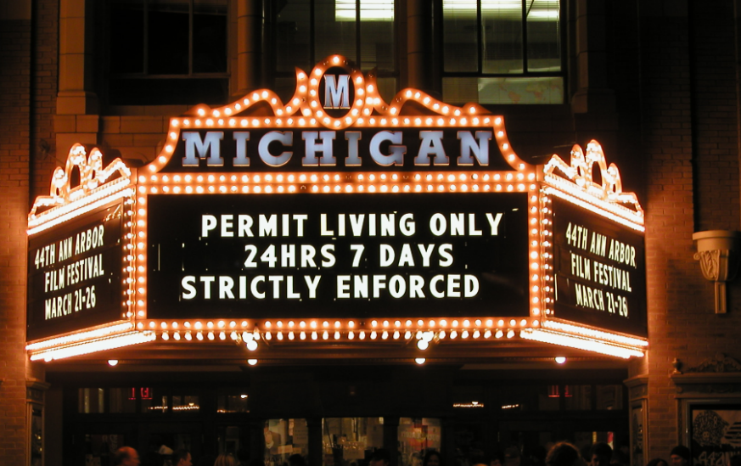
Store Front
Signs: attract attention, advertise and should be original, easily recognizable, and placed where seen (often several locations)
Awnings: architectural canopy that extends over a store’s entrance
Marquee canopy often identifiable by a surrounding cache of light bulbs, usually yellow or white, that flash intermittently

Slide 27
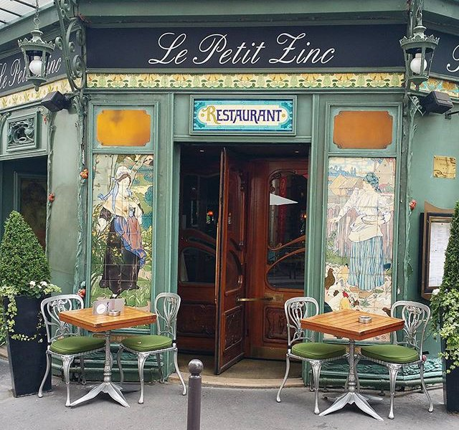
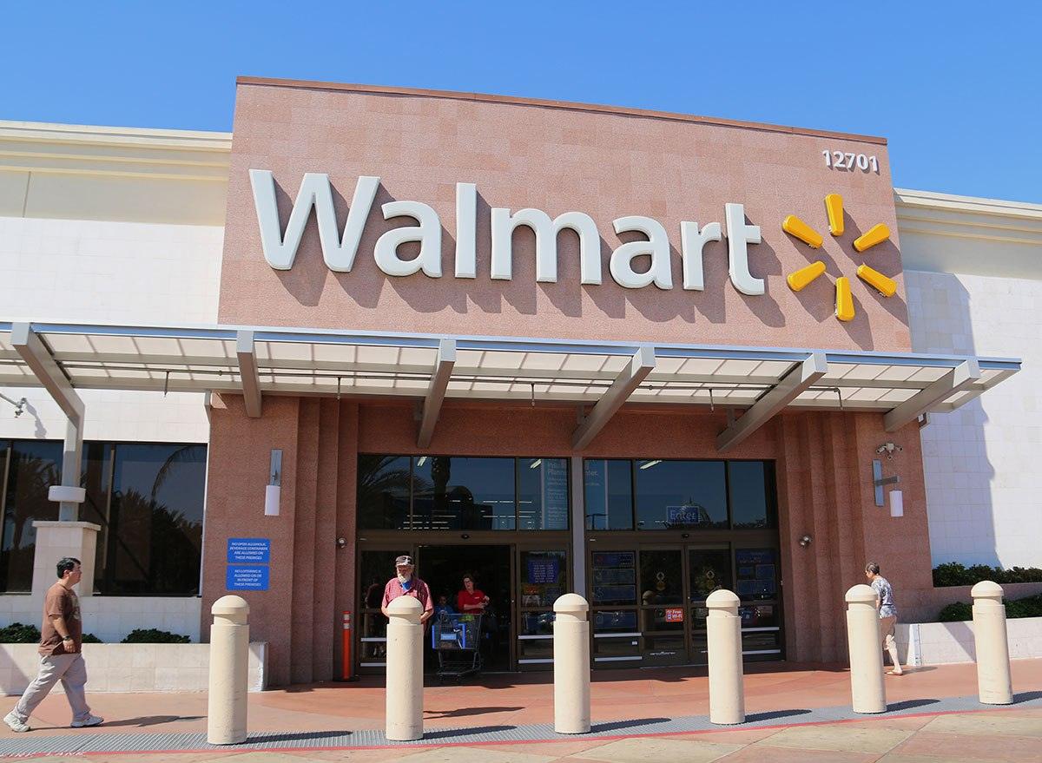
Store Front
Entrances are usually designed with customer convenience and store security in mind
Large companies have several entrances, small companies have one to two

Slide 28
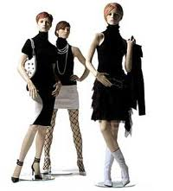
Store Interior: the visual aspects of the inside of your store that make a good selling atmosphere and that are designed around a target customer
2. Store Interior
Tools that create an inviting store interior:
Mannequins and innovative props
Seating
Floor and wall covering selections
Lighting and colors
Store fixtures, interior signage, and graphics

Slide 29
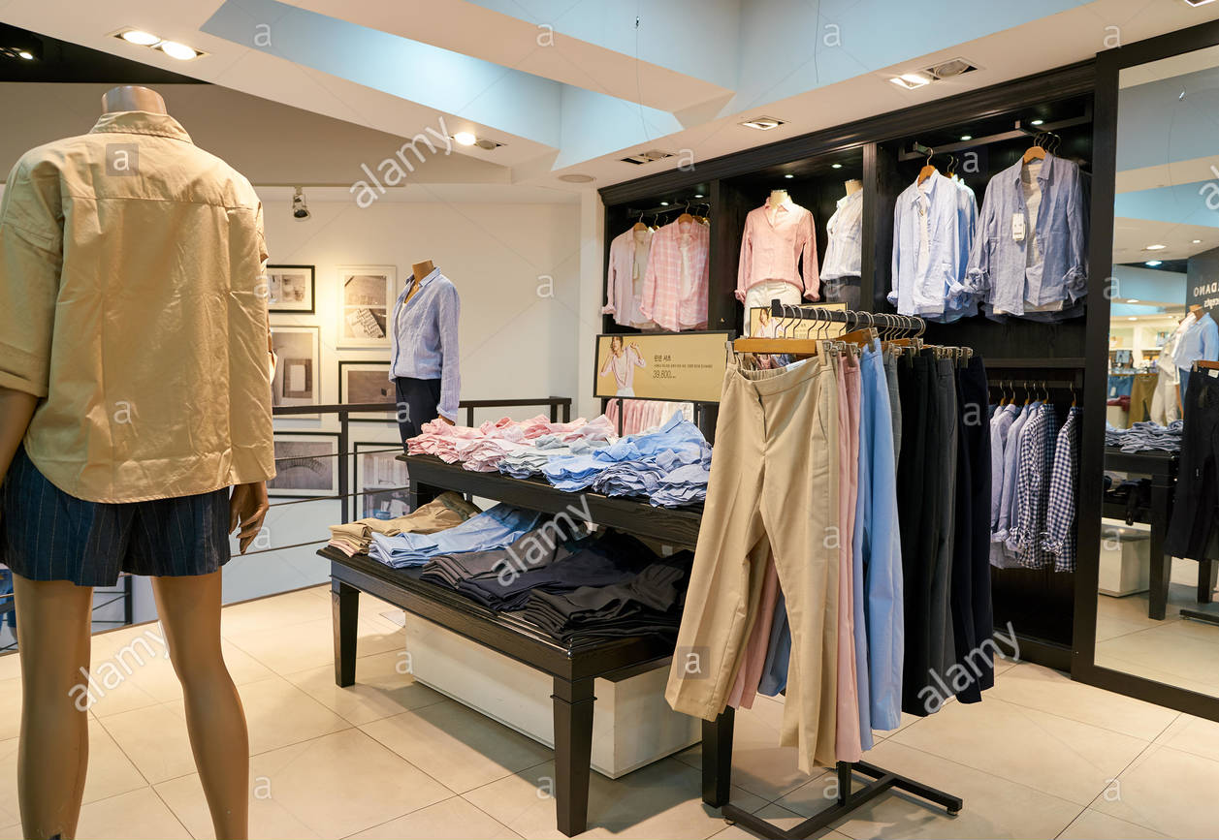
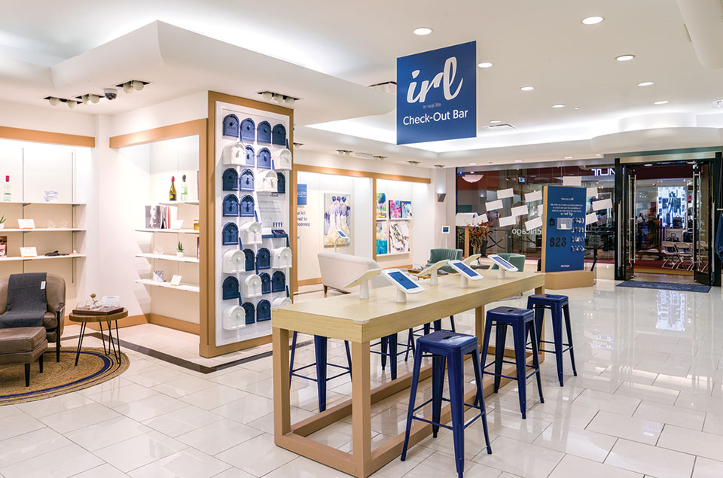
2. Store Interior
Colors & Lighting appeal to different customers
Bright colors and bright lighting for teens
Pastels and soft lighting appeals to adults
Superstores use fluorescent while prestige retailers use chandeliers and specialty lighting
Interior graphics and signs are used to promote items or give store directions
Walls are covered to reinforce store image or used to display merchandise above eye line

Slide 30
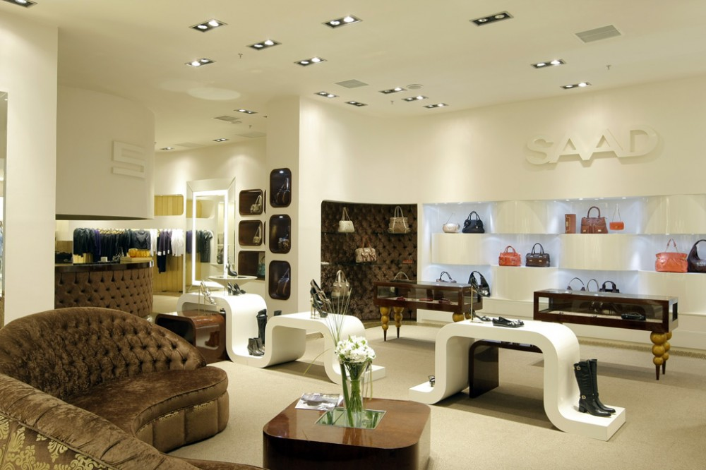
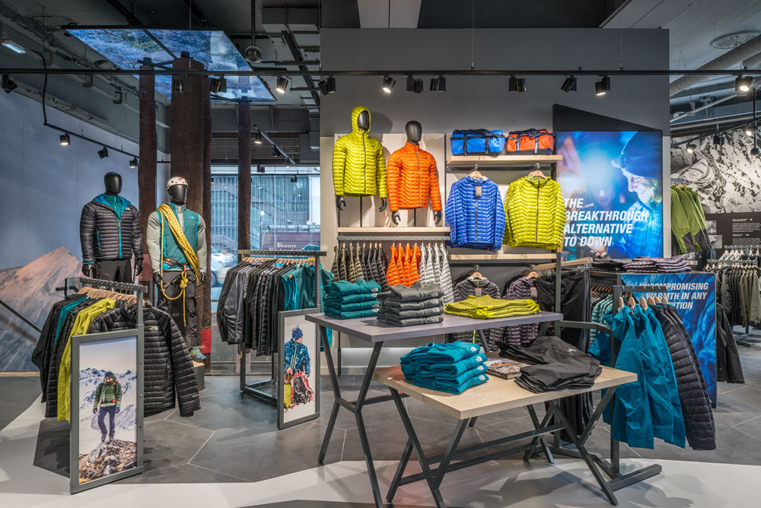
Who is your target customer?
High end, upper class, middle class, or everyone?
Probably higher class, wealthy women in the 30s and older
Who is your target customer on the right?
High end, upper class, middle class, or everyone?
Probably middle class, active men in their the 30s – 50s

Slide 31
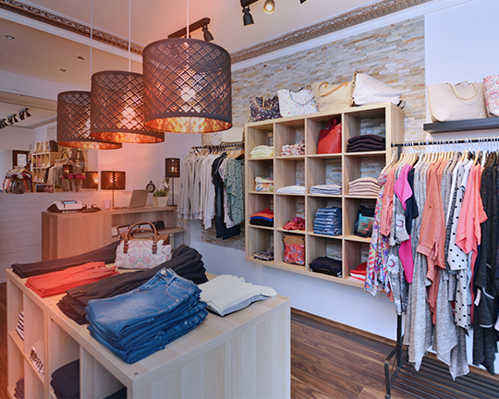
fixtures X. Fixtures are permanent or movable store furnishings that hold and display merchandise
The basic types of fixtures include:
Display cases, tables, and counters
Shelving units, racks, and bins

Slide 32
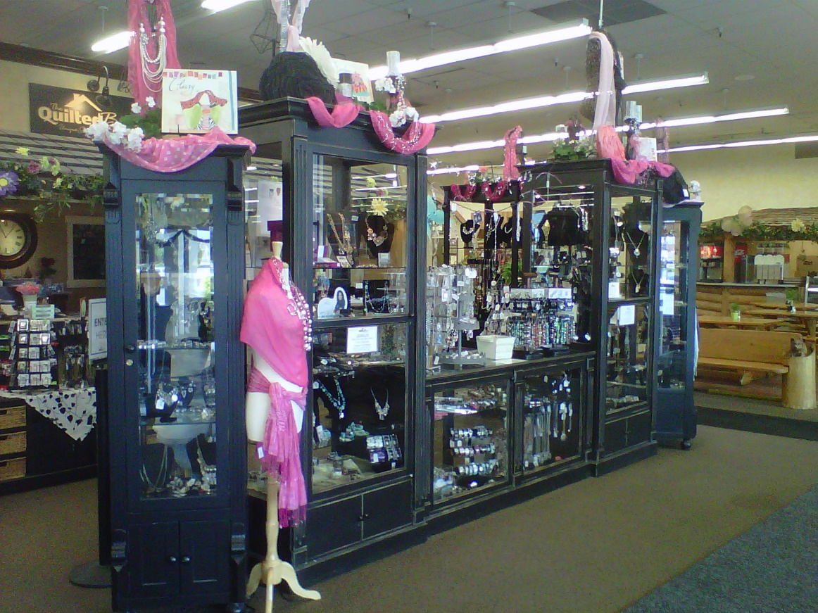
Interior Displays: creative, innovative, or well-organized ways to showcase your products with stands/display cases
If interior displays are done well, they enable customers to make a selection without the assistance of a salesclerk
Ex: Probably not able to do this alone but maybe that is the intent?

Slide 33
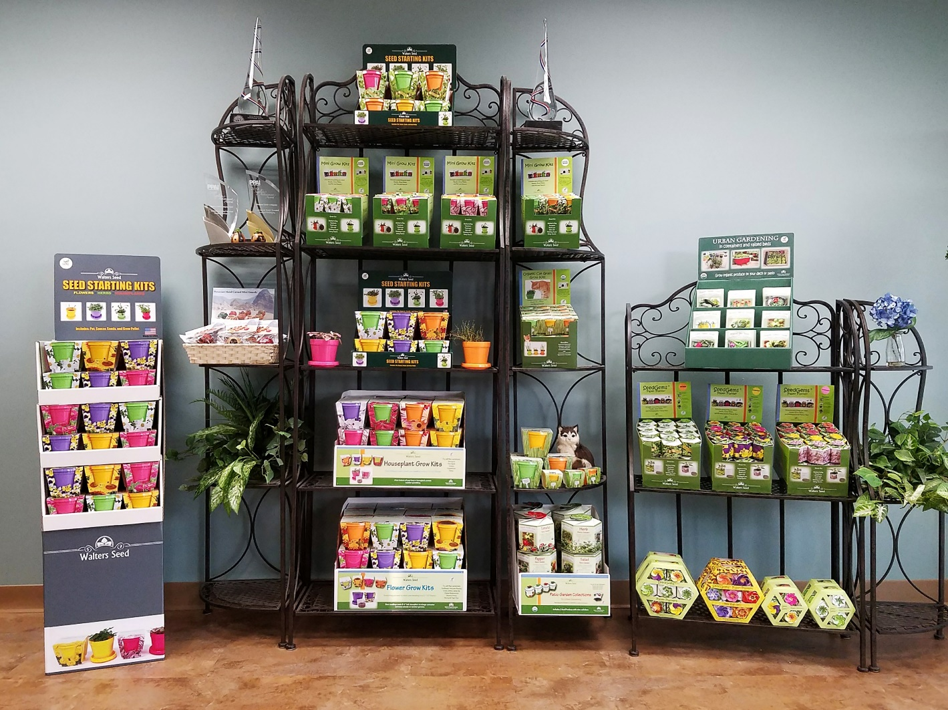
Easy to view and get product without assistance. Can view without digging and won’t have as much rearranging to do as customers won’t pick up items if they are not interested

Slide 34
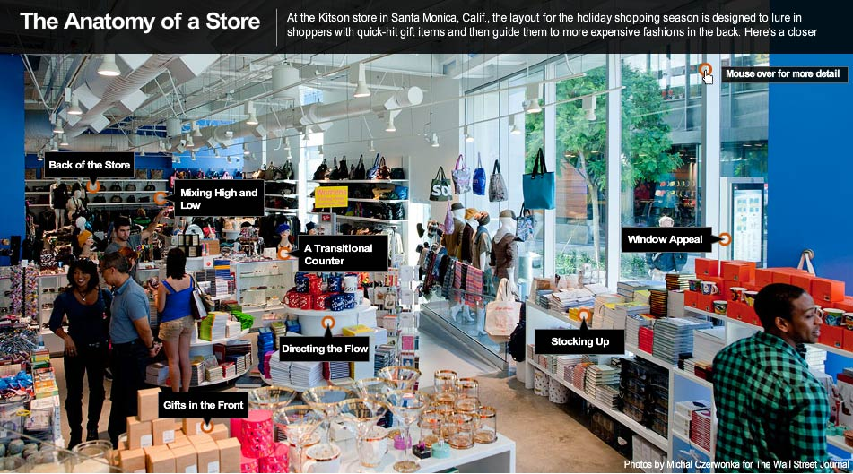
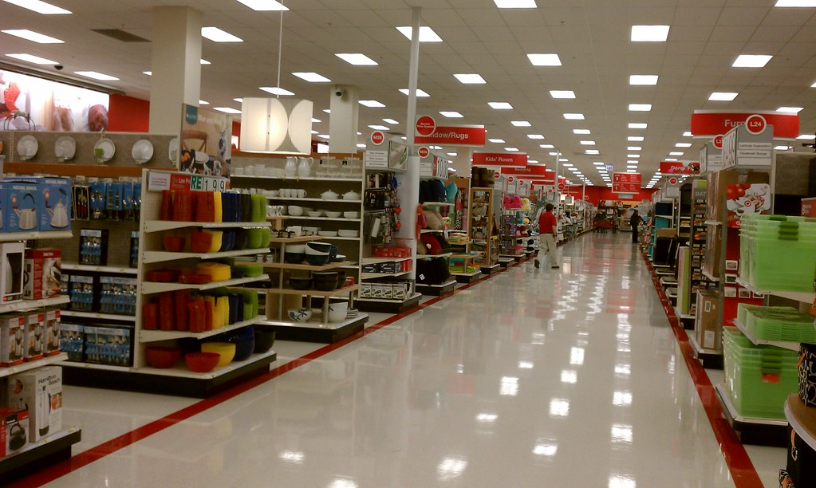
Store layout X ways a store uses floor space to facilitate and promote sales and serve customers.
2. Store Layout
Marketing Essentials Chapter 18, Section 18.1

Slide 35
2. Store Layout: the ways the store uses floor space to facilitate and promote sales
Four distinct spaces to store layout:
Selling – used for displays, wall and floor, product demonstrations, sales transactions and traffic flow
Storage spaces – items in inventory or stockrooms
Personnel space – office space, lockers, break rooms, restrooms for employee use
Customer space – designed for comfort/convenience of customer. Includes food/coffee shops ,in-store seating, lounges and children areas.

Slide 36
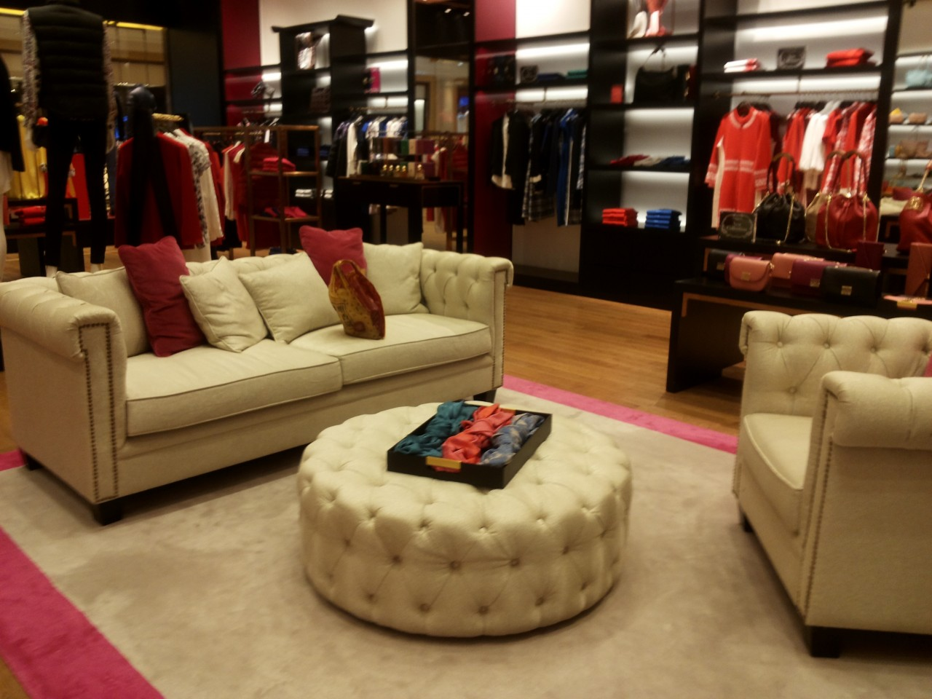
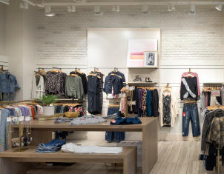
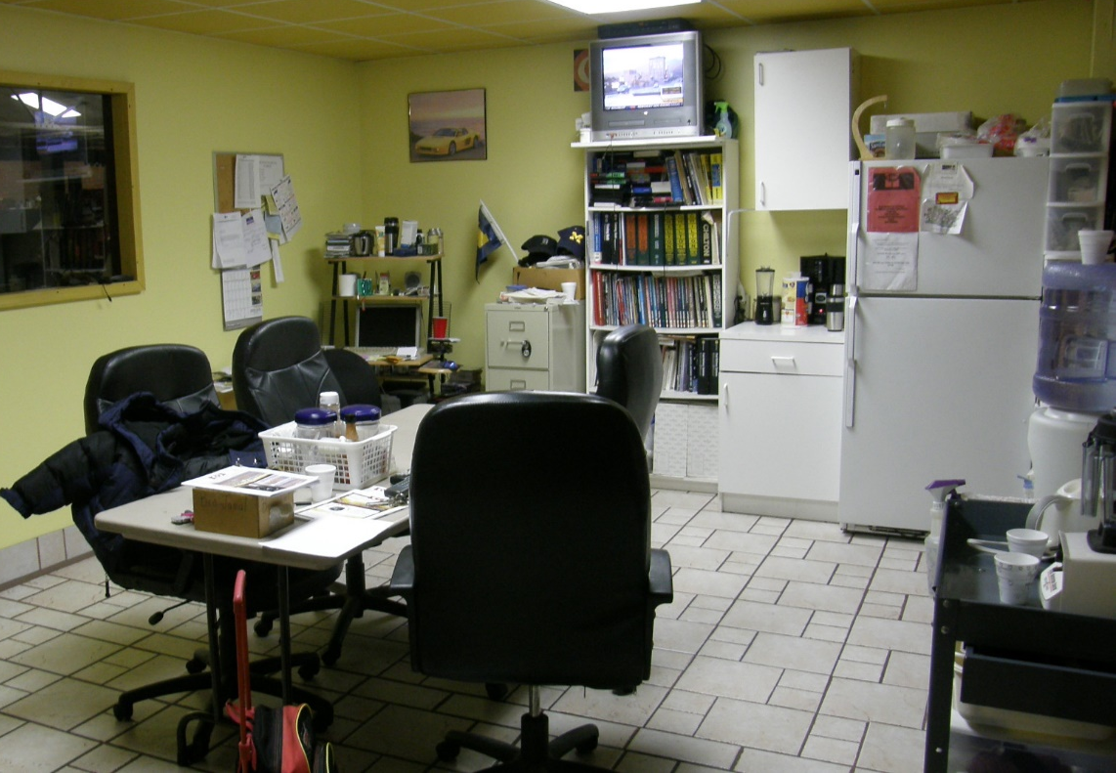
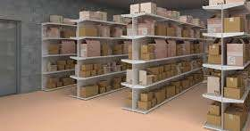
Can you identify the spaces
Upper left:
Customer Space
Upper Right:
Selling space
Lower Left:
Inventory
Lower Right
Personnel space

Slide 37
Go to Google Classroom and Complete the Lesson 18-1 Visual Merchandising assignment

Slide 38
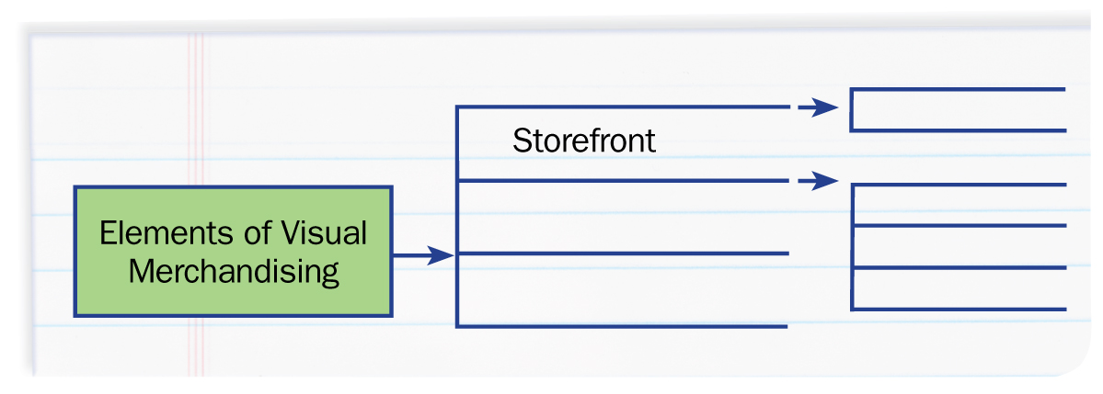
Marketing and the Marketing Concept
Graphic Organizer
Use a chart like this one to take notes on the basics of merchandising and display.
Marketing Essentials Chapter 18, Section 18.1

